Slide 1
Biomedical Imaging Nuclear Imaging (I)
Sebastian Kozerke / Markus Rudin
Institute for Biomedical Engineering, University and ETH Zurich, Switzerland

Slide 2
Today’s Learning Objectives
Review radioactivity, physical and biological half-life, radioisotopes
Relate geometrical collimation, spatial resolution and PSF
Describe scintillation detection and energy filtering
Derive image reconstruction in SPECT, PET (compare with CT)
Implement CT-based attenuation correction for PET (Exercise)
2
2

Slide 3
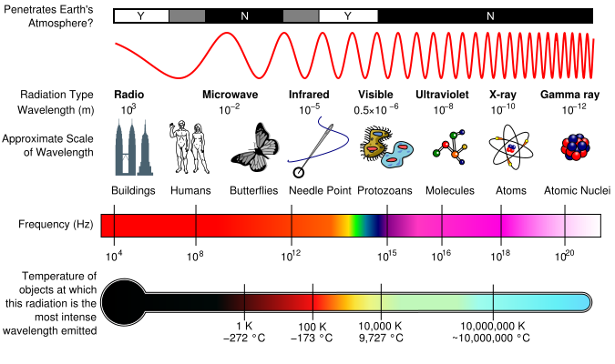
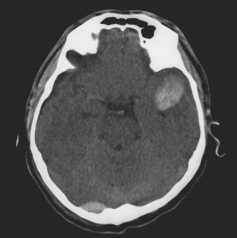
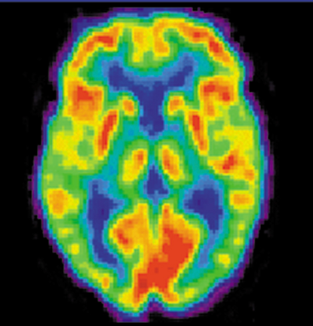
Biomedical Imaging
Radiation absorption
Magnetic Resonance
XR/CT
Nuclear Imaging
Notes:
G-rays: <10 pm
X-rays: 10 pm – 10 nm
UV: 10 nm – 400 nm
Light: 400 nm – 750 nm
IR: 750 nm – 500 um
MW: 500 um – 10 cm
RF: >10 cm

Slide 4
Nuclear imaging
Exogenous tracer as only source of imaging signal
distribution of radiotracer in tissue upon intravenous injection
radiotracer are compounds that contain metastable/instable nucleus
γ-emitter or positron emitter
tracer concentration: pmol - nmol
▶︎ Molecular and perfusion imaging

Slide 5
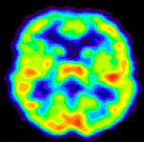
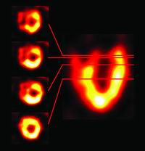
Nuclear imaging
Brain
Heart

Slide 6
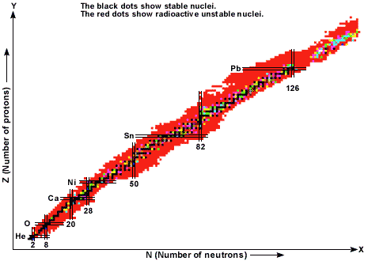
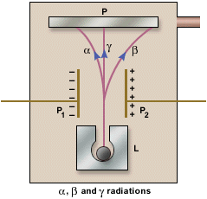
Radioactivity
Chapter 3.2
Radioactive nuclei
Decay modes
α: helium 4-nuclei
β: electrons e⁻
γ: photons
proton-rich
neutron-rich

Slide 7
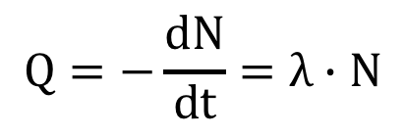
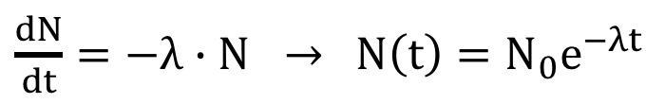
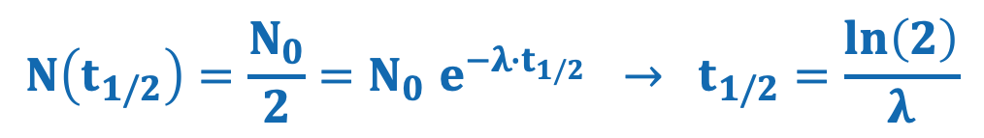
Radioactivity
First-order kinetics of radioactive decay:
$\frac{dN}{dt}=−λ∙N →$ $N\left(t\right)=N_{0}e^{−λt}$
Radioactivity = number of disintegrations per unit time:
$$Q=−\frac{dN}{dt}=λ∙N$$
Units: Curie (Ci) 1 Ci = 3.7⋅10¹⁰ disintegrations/s (=activity of 1g ²²⁶Ra)
Becquerels (Bq) 1 Bq = 1 disintegration/s
Physical half-life time:
$$N\left(t_{1/2}\right)=\frac{N_{0}}{2}{=N}_{0}e^{−λ{∙t}_{1/2}} → t_{1/2}=\frac{ln\left(2\right)}{λ}$$

Slide 8
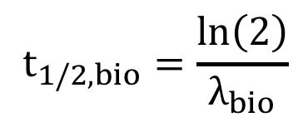
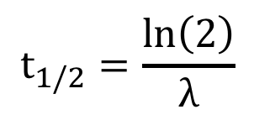
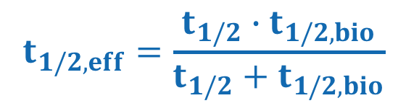
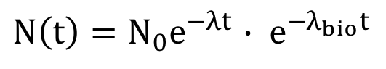
Biological half-life time
Physical half-life time:
$$t_{1/2}=\frac{ln\left(2\right)}{λ}$$
Biological half-life time:
$$t_{1/2,bio}=\frac{ln\left(2\right)}{λ_{bio}}$$
Combined tracer exposer:
$N\left(t\right)=N_{0}e^{−λt}$ $∙ e^{−λ_{bio}t}$
Effective tracer half-life time:
$$t_{1/2,eff}=\frac{t_{1/2}∙t_{1/2,bio}}{t_{1/2}+t_{1/2,bio}}$$

Slide 9
Radioisotopes
Radioisotope | Energy (keV) | Half-life | Production
⁶⁷Ga | 93, 185, 300 | 3.3d | cyclotron
^{99m}Tc | 140 | 6h | generator
¹¹¹In | 173, 247 | 67h | cyclotron
¹²³I | 160 | 13h | cyclotron
¹³³Xe | 81 | 5.2d | reactor
²⁰¹Tl | 60, 83 | 73h | cyclotron
Notes:
TI thalium

Slide 10
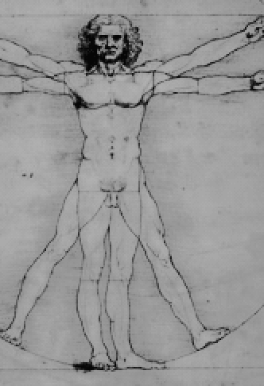
Challenge
e⁻
n → p⁺ + e⁻ + h⋅ν
γ-photon
▶︎ How to generate spatial resolution?

Slide 11
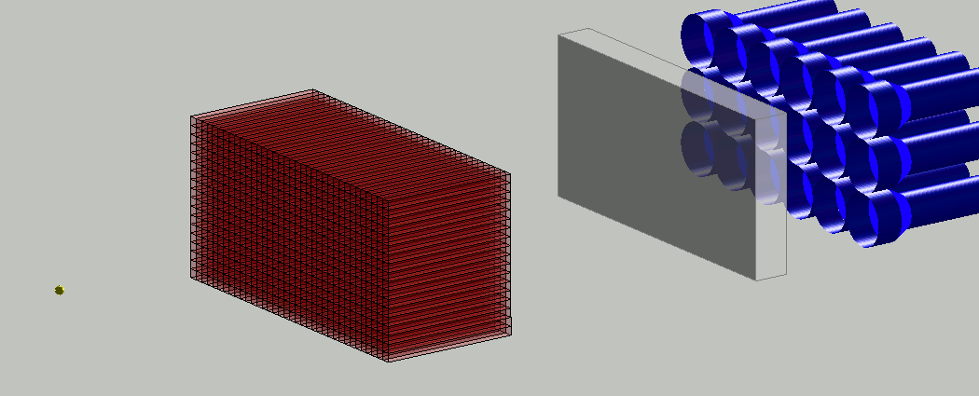
Collimation
Chapter 3.6
▶︎ Geometrical collimation provides spatial information at the expense of reduced sensitivity (only a small fraction of decays will be detected)
Notes:
TI thalium

Slide 12
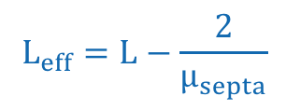
Collimator geometries
image plane
parallel
converging
diverging
x_{i}
L
x_{o}
object plane
scanning large body regions
improved resolution of small region of interest
Ratio of object size to image size depends on collimator geometry and distance of object plane-collimator plane x_{o} and image plane-collimator plane x_{i}
Effective septal length (L_{eff}) is slightly shorter than the actual physical length (L) of the septa due to residual γ-ray transmission:
$$L_{eff}=L−\frac{2}{μ_{septa}}$$

Slide 13
Geometrical collimation
detector area
visible
R
o
r
col
0
I
L_{eff}
x

Slide 14
Point-spread function
eff
Point-spread function (PSF) with full-width-at-half-maximum of Δr_{col}
$R_{0}\left(x\right)=\frac{2∙r_{col}}{L_{eff}}\left(x+\frac{L_{eff}}{2}\right)$ ${ Δr}_{coll}\left(x\right)=\frac{2∙r_{col}}{L_{eff}}\left(x+L_{eff}\right)$

Slide 15


Clicker Activity (5 min)
Assume a cylindrical collimator of a radius of r_{col}=2mm and length of l=40mm.
The object plane shall be at a distance of x=60mm from the collimator. What is the maximal distance from the collimator axis, at which the scintillation crystal still detects incoming γ-photons?
• 16 mm
• 8 mm
• 4 mm
• 2 mm
?
Scintillator
Collimator
r_{col}
l
x
Object plane

Slide 16
Gamma camera
Chapter 3.6
Notes:
TI thalium

Slide 17
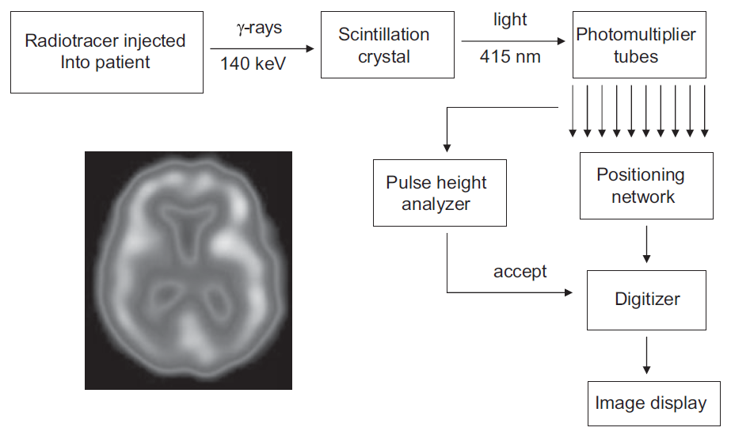
Gamma camera

Slide 18
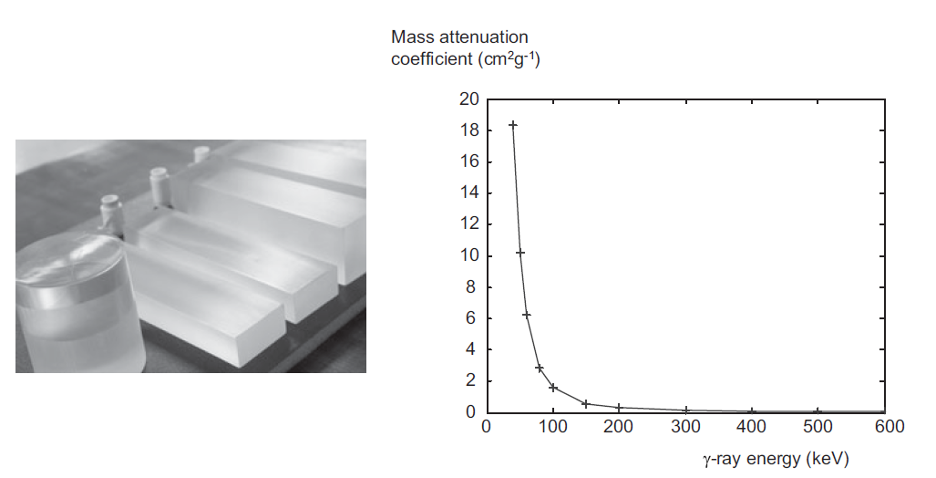
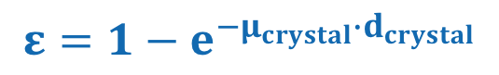
Scintillation detection
NaI(Tl)
Photo effect and Compton scattering cause excited electronic states in scintillation crystal ▶︎ photon emission (e.g. 415 nm for NaI(TI))
Detection efficiency ε:
$$ε=1−e^{−μ_{crystal}∙d_{crystal}}$$
μ_{crystal} : attenuation coefficient
d_{crystal} : crystal thickness

Slide 19
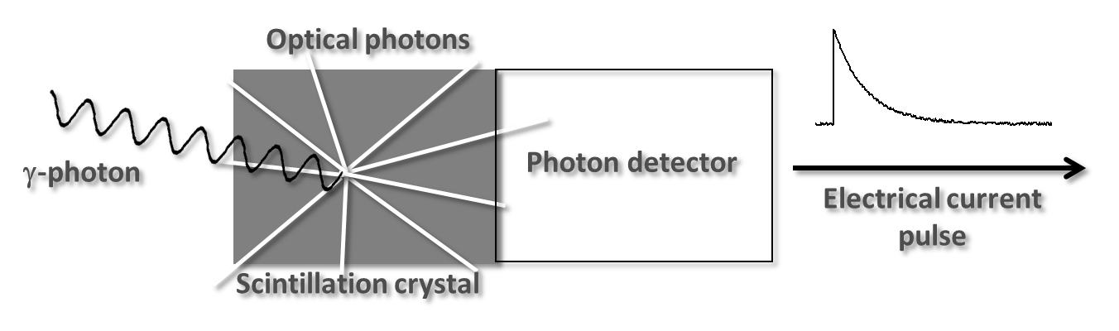
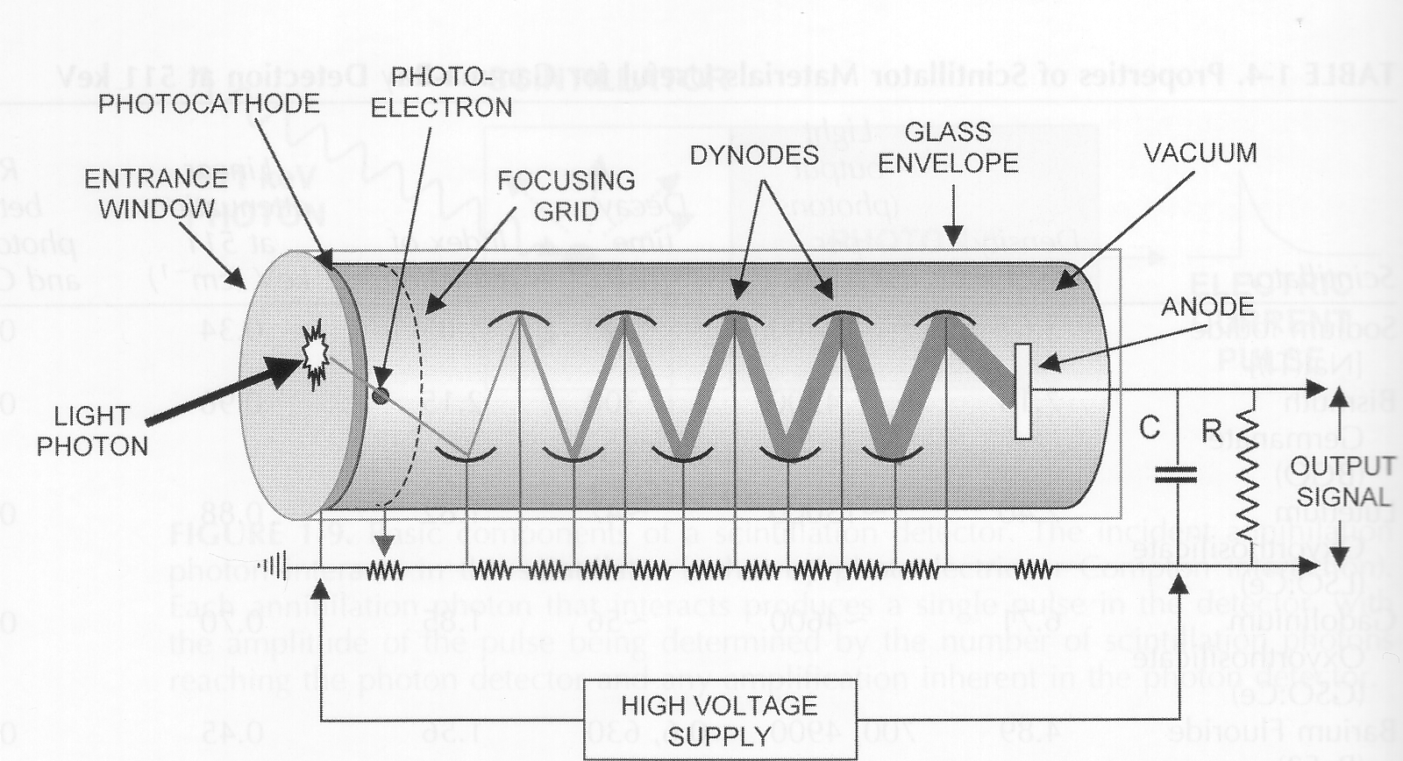
Photomultiplier tube (PMT)

Slide 20
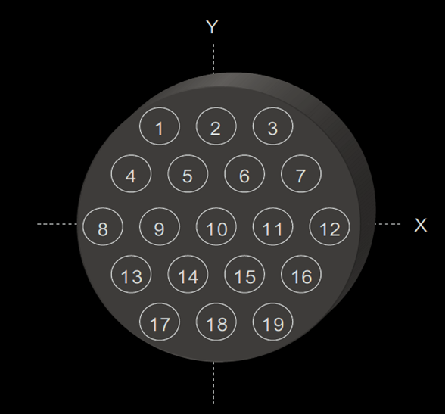
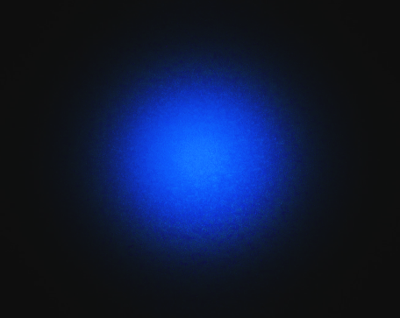
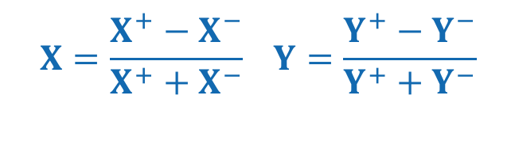
Positioning network
Spatial response is inferred by combined analysis of output of all photomultiplier tubes
Location along X and Y is determined according to:
$$X=\frac{X^{+}−X^{−}}{X^{+}+X^{−}} Y=\frac{Y^{+}−Y^{−}}{Y^{+}+Y^{−}}$$

Slide 21
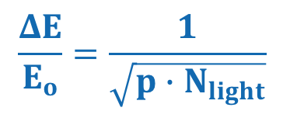
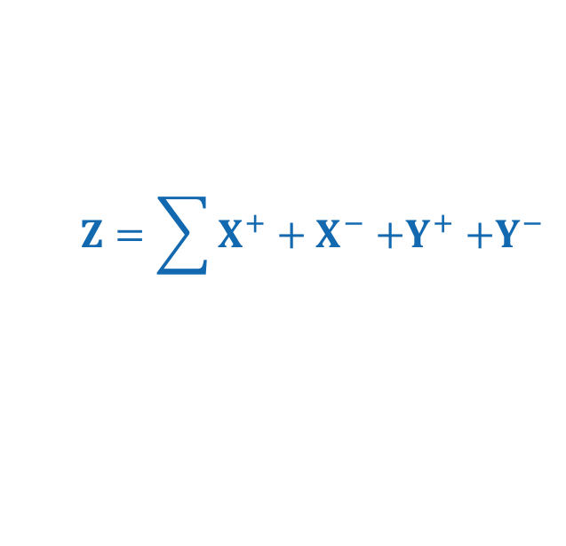
Pulse height analyzer
photo-peak
(unscattered primary photons)
lead
peak
iodine escape peak
Flux
ΔE
Compton scattering range
E₀
100
140
E (keV)
Pulse height (Z-signal) is sum of output of all PMTs:
$$Z=\sum{X^{+}+X^{−}{+Y}^{+}+Y^{−}}$$
$$\frac{ΔE}{E_{o}}=\frac{1}{\sqrt{p∙N_{light}}}$$
ΔE FWHM of energy peak of primary γ-quanta
E₀ Average energy of primary (unscattered) γ-photons
N_{light} Number of light photons produced by γ-quantum
p Probability that light photon induces electron in PMT
Energy resolution of PMT:

Slide 22
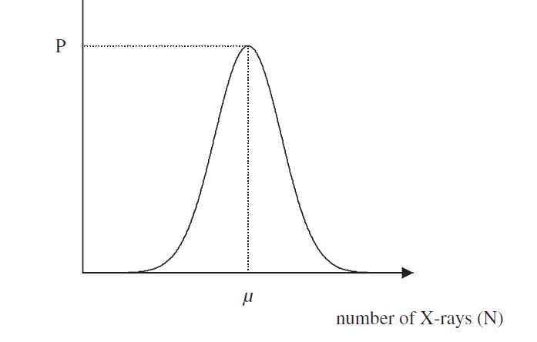
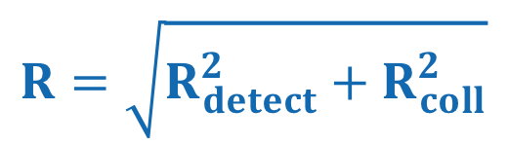

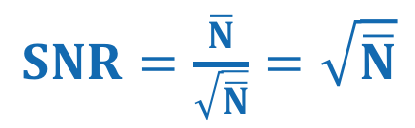
Signal-to-noise ratio and spatial resolution
Chapter 3.7
Poisson distribution
Signal-to-noise ratio (SNR)
$SNR=\frac{\overline{N}}{\sqrt{\overline{N}}}=$ $\sqrt{\overline{N}}$
$$\overline{N}$$
number of γ-photons (N)
Spatial resolution
γ
$R=$ $\sqrt{R_{detect}^{2}+R_{coll}^{2}}$
crystal
DOI
R_{coll} (see above), R_{cdetect} reflect uncertainty in measurement location of scintillation event (depth of interaction DOI error; error in PMT estimation)
PMT

Slide 23
Single photon emission computer tomography (SPECT)

Slide 24
SPECT
Chapter 3.9
▶︎ Systems with rotating gamma camera

Slide 25
SPECT image reconstruction
▶︎ Image reconstruction using Filtered Backprojection

Slide 26
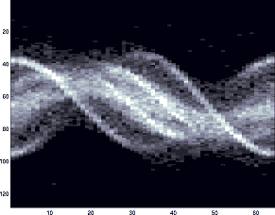
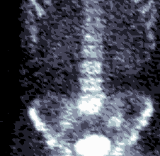
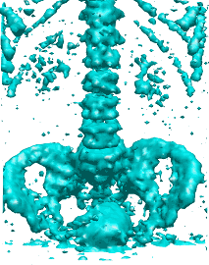
SPECT 3D reconstruction
Sinogram
Reconstruction
human skeleton using ^{99m}Tc based bone tracer
http://www.physics.ubc.ca

Slide 27
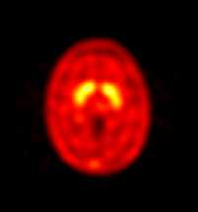
SPECT applications
Chapter 3.12
Dopamine transporter imaging
SPECT radioligand is derivative of tropane ligand family and labeled with ^{99m}Tc
reflects location of dopamine transporter
in caudate putamen.
▶︎ in Parkinson patients receptor density is significantly reduced.
Notes:
Dopamine is a catecholamine neurotransmitter present in a wide variety of animals, including both vertebrates and invertebrates. In the brain, this phenethylamine functions as a neurotransmitter, activating the five types of dopamine receptors—D1, D2, D3, D4, and D5—and their variants. Dopamine is produced in several areas of the brain, including the substantia nigra and the ventral tegmental area.[1] Dopamine is also a neurohormone released by the hypothalamus. Its main function as a hormone is to inhibit the release of prolactin from the anterior lobe of the pituitary.
Dopamine is available as an intravenous medication acting on the sympathetic nervous system, producing effects such as increased heart rate and blood pressure. However, because dopamine cannot cross the blood-brain barrier, dopamine given as a drug does not directly affect the central nervous system. To increase the amount of dopamine in the brains of patients with diseases such as Parkinson's disease and dopa-responsive dystonia, L-DOPA, which is the precursor of dopamine, can be given because it can cross the blood-brain barrier.

Slide 28
MicroSPECT
Pinhole
Standard detector
Miniaturized detector

Slide 29


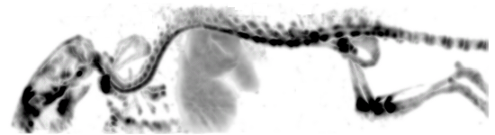




MicroSPECT
High-resolution mouse imaging
courtesy F Beekman

Slide 30
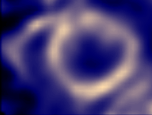
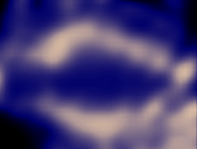
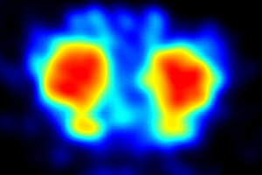

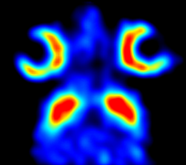
MicroSPECT
Mouse brain
dopamine transporter
Mouse heart
perfusion
courtesy F Beekman

Slide 31
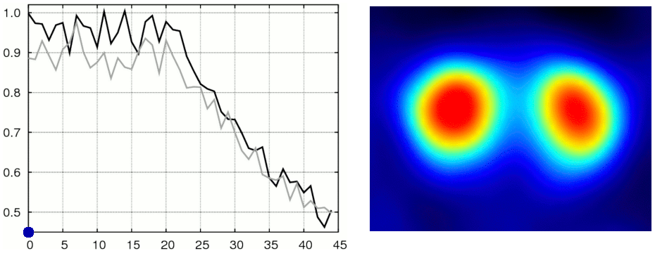
MicroSPECT
Dynamic SPECT of dopamine transporters in mouse brain
Cocaine injection
Time (minutes)
Left Caudate Putamen
Right Caudate Putamen
courtesy F Beekman
Notes:
Dopamine is commonly associated with the reward system of the brain, providing feelings of enjoyment and reinforcement to motivate a person proactively to perform certain activities. Dopamine is released (particularly in areas such as the nucleus accumbens and prefrontal cortex) by rewarding experiences such as food, sex, drugs, and neutral stimuli that become associated with them. Recent studies indicate that aggression may also stimulate the release of dopamine in this way.[19]
This theory is often discussed in terms of drugs such as cocaine, nicotine, and amphetamines, which directly or indirectly lead to an increase of dopamine in the mesolimbic reward pathway of the brain, and in relation to neurobiological theories of chemical addiction (not to be confused with psychological dependence), arguing that this dopamine pathway is pathologically altered in addicted persons.[20][21][22]
[edit]Reuptake inhibition, expulsion
Cocaine and amphetamines inhibit the re-uptake of dopamine; however, they influence separate mechanisms of action. Cocaine is a dopamine transporter and norepinephrine transporter blocker that competitively inhibits dopamine uptake to increase the lifetime of dopamine and augments an overabundance of dopamine (an increase of up to 150 percent) within the parameters of the dopamine neurotransmitters. Like cocaine, amphetamines increase the concentration of dopamine in the synaptic gap, but by a different mechanism. Amphetamines and methamphetamine are similar in structure to dopamine, and so can enter the terminal bouton of the presynaptic neuron via its dopamine transporters as well as by diffusing through the neural membrane directly.[citation needed] By entering the presynaptic neuron, amphetamines force dopamine molecules out of their storage vesicles and expel them into the synaptic gap by making the dopamine transporters work in reverse.

Slide 32
Chapter 3.13
Positron emission tomography (PET)

Slide 33
Positron emitters
Chapter 3.14
Radionuclide | Half-life | E_{max} (MeV) | e⁺ decay (%)
¹¹C | 20.4 min | 0.96 | 100
¹³N | 10 min | 1.20 | 100
¹⁵O | 2 min | 1.73 | 100
¹⁸F | 110 min | 0.63 | 97
²²Na | 2.6 y | 0.55 | 90
⁶²Cu | 9.7 min | 2.93 | 97
⁶⁴Cu | 12.7 h | 0.65 | 29
⁶⁸Ga | 67.6 min | 1.89 | 89
⁷⁶Br | 16.2 h | Various | 56
⁸²Rb | 1.3 min | 2.60, 3.38 | 96
¹²⁴I | 4.2 d | 1.53, 2.14 | 23

Slide 34
Positron annihilation
Compton scattering
γ(511 keV)
positron emitting radionuclide
e⁻
e⁺
nuclear decay p⁺ → n⁰ + e⁺ + ν
γ(511 keV)
annihilation e⁺ + e⁻ → γ + γ
Coincidence detection of two g-photons gives information on location of positron-electron annihilation (not on location of radionuclide)

Slide 35
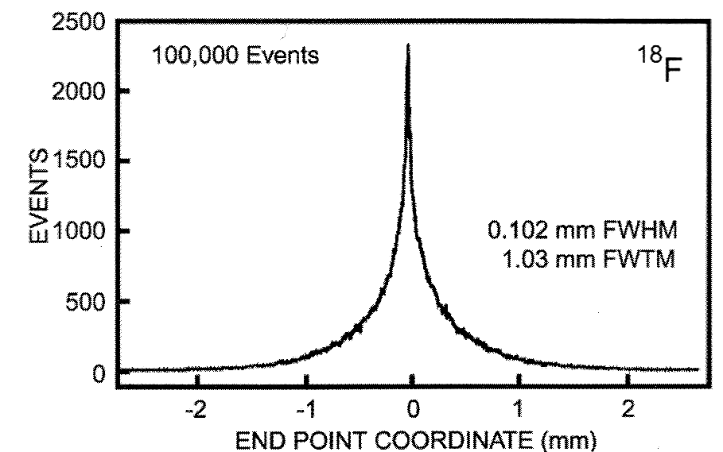
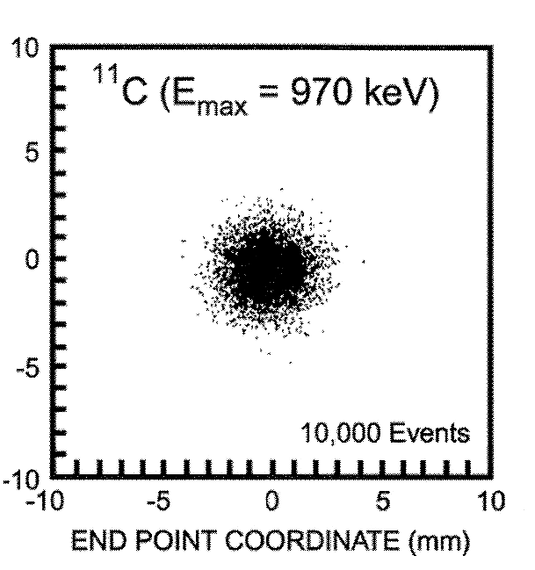
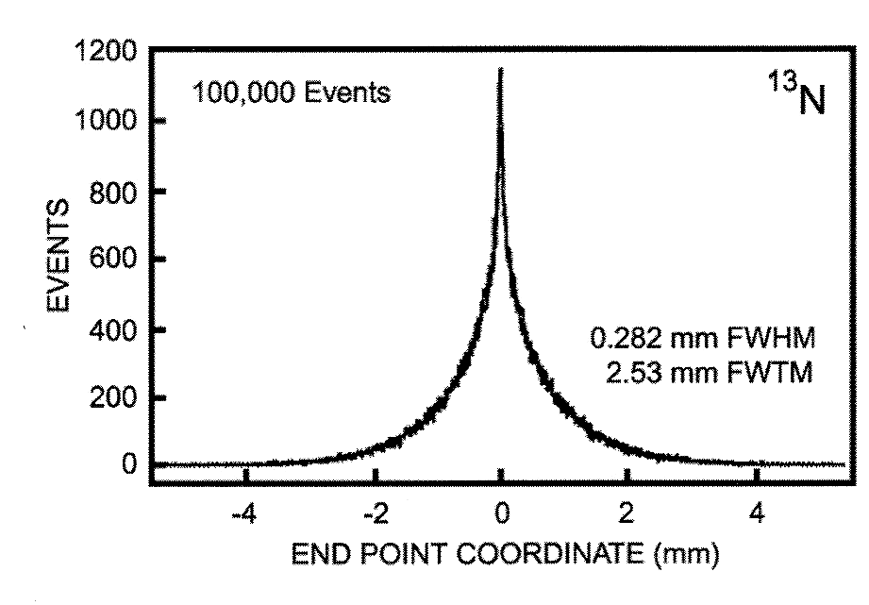
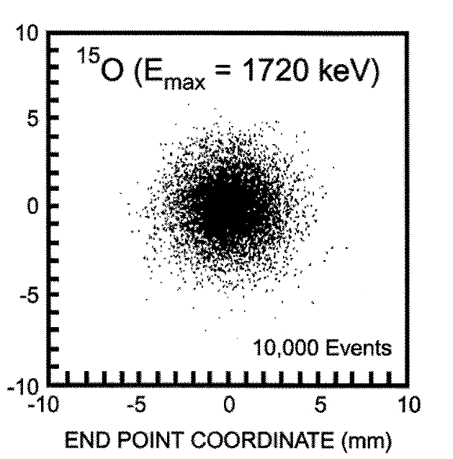
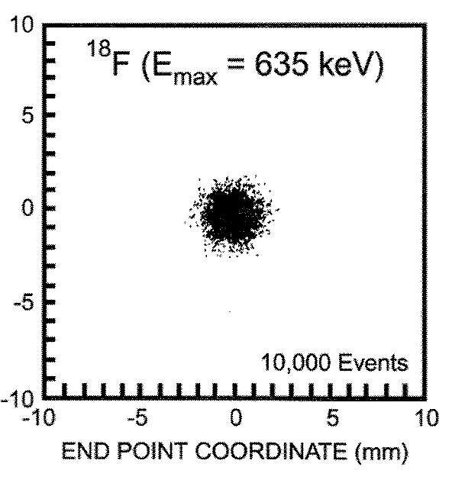
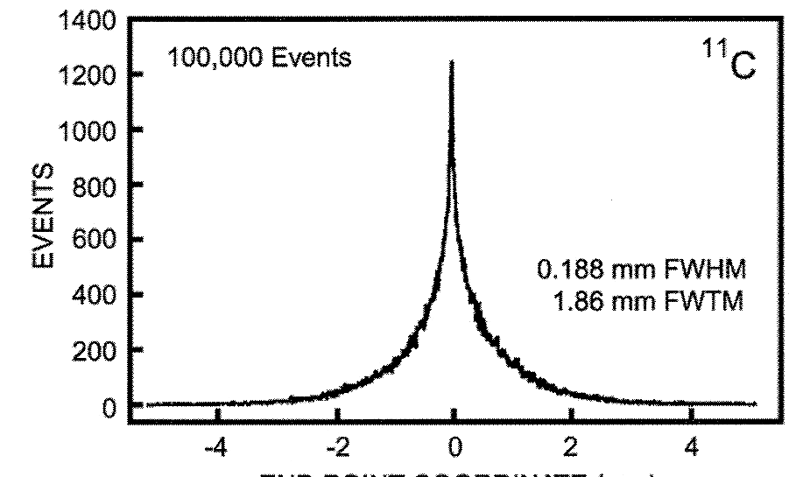
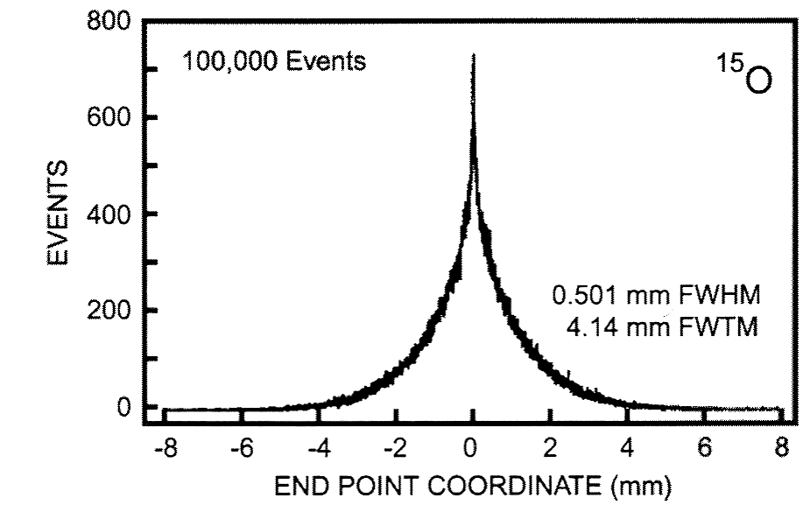
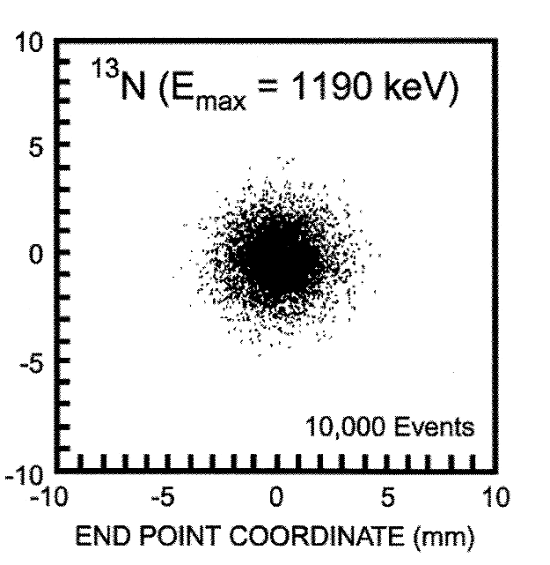
Positron annihilation range
E_{max}=635keV
E_{max}=970keV
E_{max}=1190keV
E_{max}=1720keV
¹⁸F
¹¹C
¹³N
¹⁵O
Levin, Hoffmann, Phy Med Biol 44: 781-799 (1999)

Slide 36
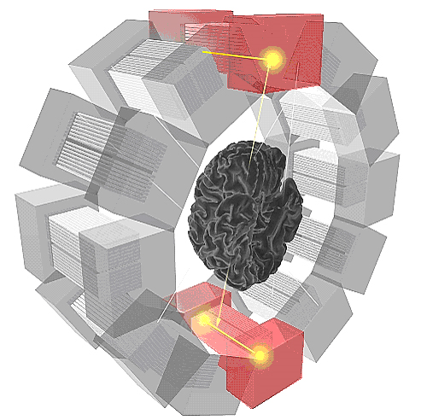
Coincidence detection
Chapter 3.15
Image courtesy of HUG
Notes:
Registration of event:
Coincidence detection, i.e.
two events occuring within a
time window Dt attributed to
One anihilation event
| t1 - t2 | < Δt
Resolution:
- Positron lifetime -> 0.3-1 mm
Number of detectors and size of detector
Off-center position
Setting of Δt
colineraity

Slide 37
Coincidence detection
τ
A
A
B
threshold
B
A+B
Coincidence window 2τ

Slide 38
Clicker Activity (5 min)
What is the maximum possible time difference of scintillation events in this example?
• 12 ns
• 24 ns
• 1.2 ns
• 2.4 ns
Detector ring
35 cm
25 cm
Human body
45 cm

Slide 39
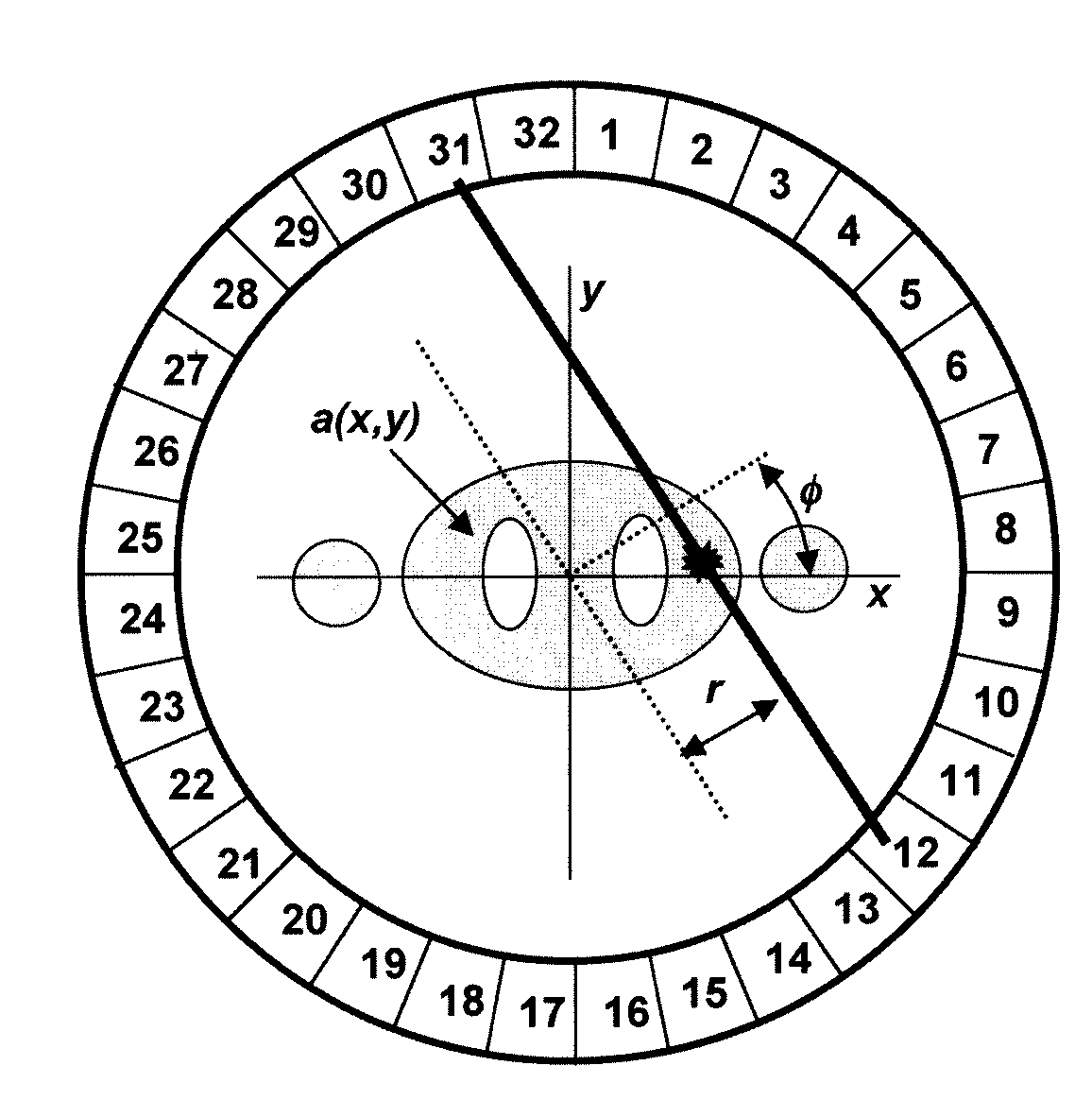

Line of Response (LoR)
r
φ
y
x
$r=x∙cosφ+$ $y∙sinφ$

Slide 40
Image reconstruction
CT
PET
X-ray source
y
y
φ
φ
r
r
x
x
LoR
s
s
Detector
Detector ring
▶︎ Image reconstruction using FBP

Slide 41
Scintillation crystals
Scintillation crystal | Density g/cm³ | Light φ per 511 keV | Decay time (ns) | Linear attenuation (cm⁻¹)
Sodium Iodide NaI(Tl) | 3.67 | 19400 | 230 | 0.34
Bismuth Germanate BGO | 7.13 | 4200 | 300 | 0.96
Lutetium Orthosilicate LSO | 7.40 | 13000 | 47 | 0.88
Gadolinium Orthosilicate GSO | 6.71 | 4600 | 56 | 0.70

Slide 42

Detector
Block of scintillation crystal
S_{C}
S_{A}
Reflector material
S_{D}
S_{B}
Four single channel photomultiplier tubes
Geometrical information

Slide 43

Geometric correction
Derivation of
geometrical information
Flood histogram
y
A
B
x
C
D
Correction

Slide 44

Point-spread function
w
Detector
r
x
Annihilation
0
$$FWHM=\frac{w}{2}$$
Detector

Slide 45



Point-spread function
Detector
r
x
$$FWHM=w\frac{r+x}{2r}$$
x
0
$$FWHM=\frac{w}{2}$$
y
r
Detector
w
$$\frac{y}{w}=\frac{r−x}{2r} FWHM=w−y=w−\frac{r−x}{2r}w=w\frac{r+x}{2r}$$

Slide 46

Axial coverage
r
ζ
ζ
z/2
z/2
$$tanζ=\frac{z}{2r}=\frac{z}{D}$$

Slide 47



Detection and geometric efficiency
Detection efficiency
$$ε=\left(1−e^{−μ∙d}\right)∙φ$$
single detector
efficiency
$$ε^{2}={\left(1−e^{−μ∙d}\right)}^{2}φ^{2}$$
coincidence detector
crystal thickness d
Fraction of events within energy window: Φ
Attenuation by scintillation crystal: μ
z
Geometric efficiency
$$Ω=sin\left(\tan^{−1}\left(\frac{z}{D}\right)\right)$$
D

Slide 48


Total sensitivity
Radial coverage
$$θ=\frac{x∙y}{\left(x+x_{d}\right)∙\left(y+y_{d}\right)}$$
y_{d}
y
x
x_{d}
Total sensitivity
$$η=ε^{2}∙θ∙Ω$$

Slide 49

Attenuation correction
Chapter 3.18

Slide 50



Attenuation correction
Loss of γ-photons due to Compton scattering
$$p_{1ij}=e^{−μ∙x_{ij}}$$
D_{ij}-x_{ij}
x_{ij}
$$p_{2ij}=e^{−μ∙\left(D_{ij}−x_{ij}\right)}$$
Total scattering probability
$$p_{ij}=p_{1ij}∙p_{2ij}=e^{−μ∙D_{ij}}$$

Slide 51

Attenuation correction
1.0
Scattering probability
0.5
Intensity
0
-1
0
1
y-coordinate
Attenuation correction
$$a_{ij}=\frac{1}{p_{ij}}=e^{μ∙D_{ij}}$$

Slide 52

Attenuation correction
Attenuation correction
*
=

Slide 53
“The most important slides”

